Slide 1
Computer Network for Web Developer

Slide 2
Objectives
Understand what is computer Networks
Understand the foundation of communication systems
Understand Domain Name System
Checking network connectivity
Tracing communication

Slide 3

What Is Computer Networks
When people are talking to each other we call it they are networking for the following reasons:
There are at least two people are engaged
To be able to communicate they have to talk in a common language
Their voice must be deliverable

Slide 4
What is Computer Networking
Similarly,
Two or more people talking = two or more computers communicating
Common language = Communication model
Voice delivery = network medium

Slide 5
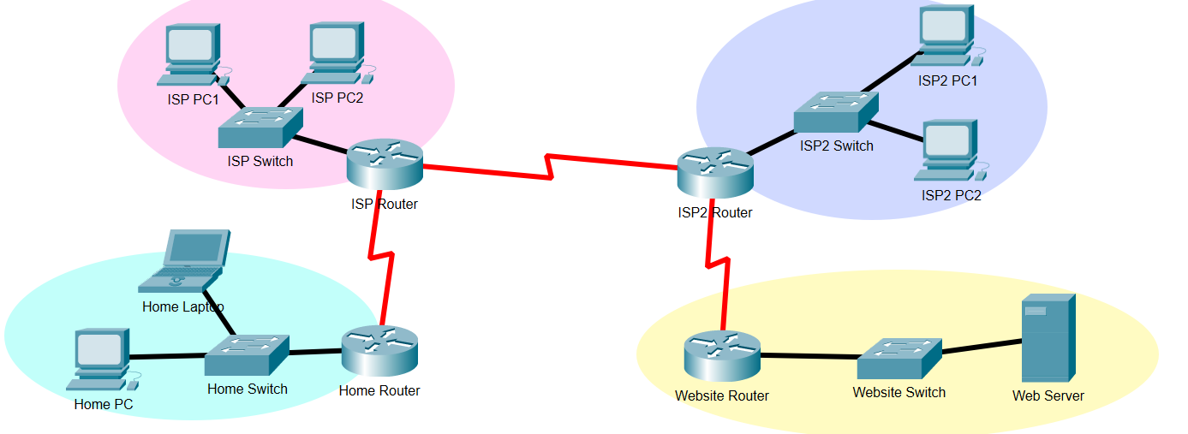
What is Computer Networking

Slide 6
Communication Models
Modern communication models use layered stacked models.
Layered stacked models give the following advantages:
Simplicity (architecture and Learning)
Modularity
Development
Interoperability

Slide 7
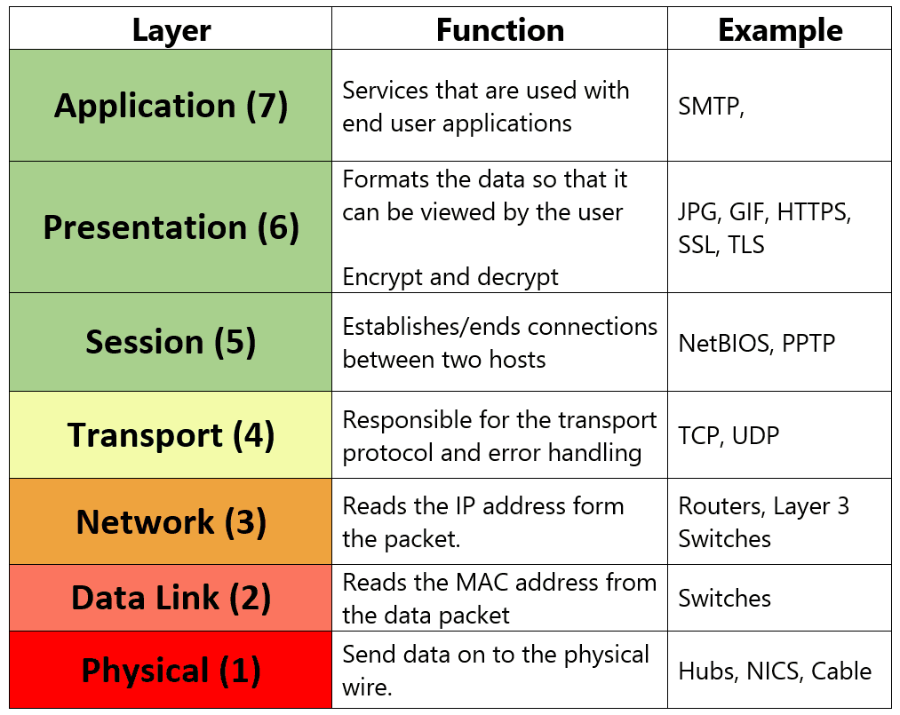
OSI Communication Models

Slide 8
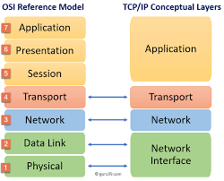
TCP/IP Communication Models

Slide 9

Transmission Process
Sender
Receiver
Data
Data
Data
Application
D
A
Application
Transmission
D
A
T
Transmission
Internet
D
A
T
IP
Internet
Network
D
A
T
IP
N
Network

Slide 10
What is Protocol
Protocol is a set of rules that regulate how the operation will be performed. For instance, browsing web or sending email.
There is a specific protocol for each application that regulate and govern how the operation would be performed.

Slide 11
IP Address (v4)
32 binary bits.
Ip address is represented in four octets in dotted-decimal notation. For instance (192.168.1.19)
There are two parts of each address
Network
Host

Slide 12
Domain Name System
People usually find it hard to remember numbers. For example, it is hard for people to memorize all family and friends phone numbers.
Likewise, on the internet the only way to reach any website is by using IP address which is a four octet unique number.
DNS is a protocol that solves the problem of the need of memorizing all the IPs’ numbers for the domains you usually visit.

Slide 13
Domain Name System
Instead, you would only use the domain name
DNS could be described as a table that has domain name and its matching IP address
For instance, the domain (https://uncc.edu) has the IP address (152.15.47.208). Therefore, either by using the domain name or the IP address you should be able to reach the website because of DNS

Slide 14
Domain Name System
It is very important to understand that not all domains has its own dedicated IP address.
You may find multiple websites hosted on the same IP address (Shared Hosting).
It is important for any developer to understand the hierarchical of DNS as follow:

Slide 15
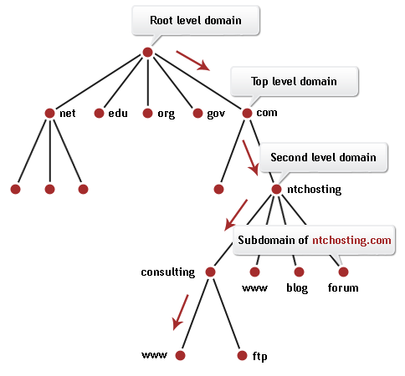
Domain Name System

Slide 16
Domain Name System

Slide 17
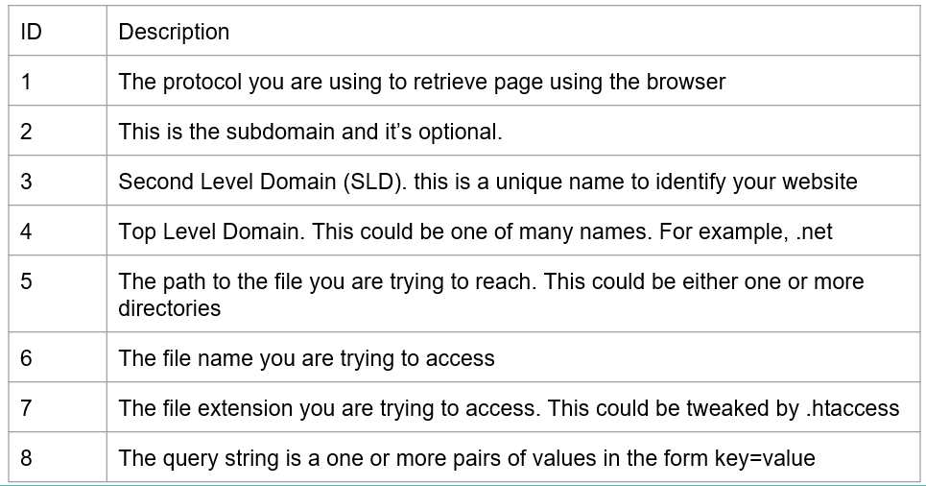
Domain Name System

Slide 18
HTTP Protocol
HyperText Transfer Protocol (HTTP) is the main protocol used nowadays for browsing the internet.
Like most protocols, HTTP was not designed at the start with security consideration in mind.
HTTP is a stateless protocol, which means every request will be dealt with separately.

Slide 19
HTTP Protocol
HTTP works in request/response pair. In another words, when a user wants to access a website a request will be sent to the server. Once the request processed then it will be returned back to the user as response.
Client
Request
Server
Response

Slide 20
HTTP Protocol (Request)
HTTP uses some methods to format the request going from the user’s browser to the server.
These methods are called verbs. There are many types, the following are the most common verbs:

Slide 21
HTTP Protocol (Request)
GET: is the most common request type used by browsers for normal resource fetching operations.
POST: is the most common request type used by browsers for submitting forms. Usually, payload is attached with this request type.
UPDATE: is most common request type used for updating a resource.

Slide 22
HTTP Protocol (Request)
DELETE: is most common type used for deleting operation

Slide 23
HTTP (Response)
HTTP responses are fixed and standardized. This helps browsers handling the response in the right way.
There is something called HTTP response which is presented by 3 digit (XXX).
The first digit from the left represent the response category. Where the the second and third digit represent error number.

Slide 24
HTTP (Response)
HTTP response categories are:
1xx: Informational Messages
2xx: Successful operation messages
3XX: Redirection messages
4XX: Errors on the client side. For example, requesting a wrong page.
5XX: Errors on the server side. For Example, an error on your application.

Slide 25
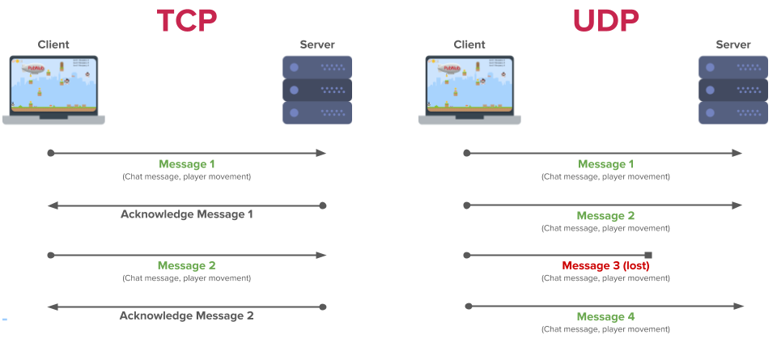
TCP or UDP

Slide 26
Checking Connectivity
Connectivity means that you can reach to one pc from another one.
You may use Ping command from the command line to ensure the connectivity.

Slide 27
Tracing packets
In some cases, you are unable to reach to a specific ip address but it gives you that destination is not reachable. What should you do in this case?
It is important as developer to know where the problem is present.
Tracing your request might give you an understanding where the problem reside
You may use traceroute command to do that.

Slide 28
IP address
Request/Response
Ping “Check connectivity”
Tracing a packet “Tracert”
DNS using NSlookup

Slide 29
Thanks

